Slide 1


NASA Jet Engine Predictive Maintenance (FD001)
Remaining Useful Life (RUL) Prediction Project
Presented by: Nael Khamess
Mentor: Jacco Oosterhuis

Slide 2



01
Project introduction
~2 minutes
The goal of this project > is to build a reliable method for predicting Remaining Useful Life (RUL) of jet engines in the NASA C-MAPSS FD001 dataset.
This supports predictive maintenance: fewer unexpected failures, better planning, and potential cost reduction.
Beginning status >I only had raw multi-sensor time-series data, and the main challenge was converting these dense sensor streams into meaningful features that a model can learn from.

Slide 3

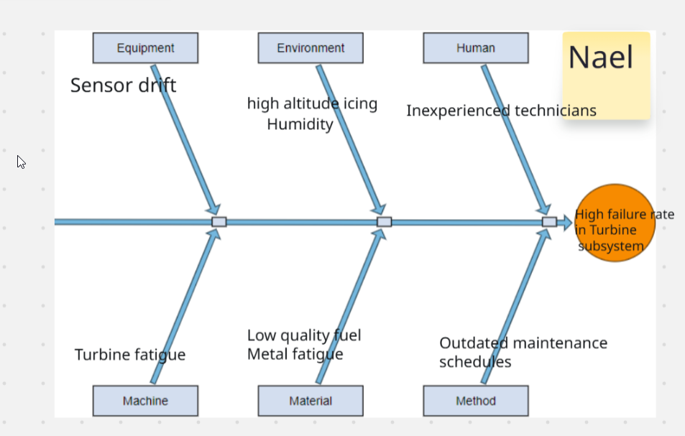
02
Project introduction
Project concept
I use ML to turn historical engine behavior into a regression model that predicts engine lifespan and therefore RUL (Remaining useful life).
This replaces manual thresholding with a data-driven forecasting approach.

Slide 4
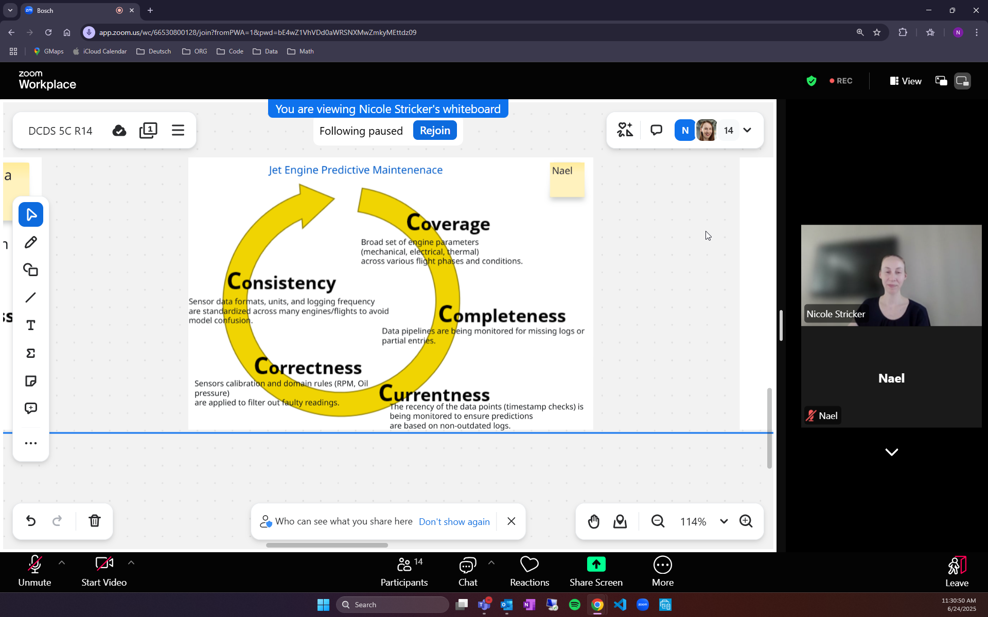
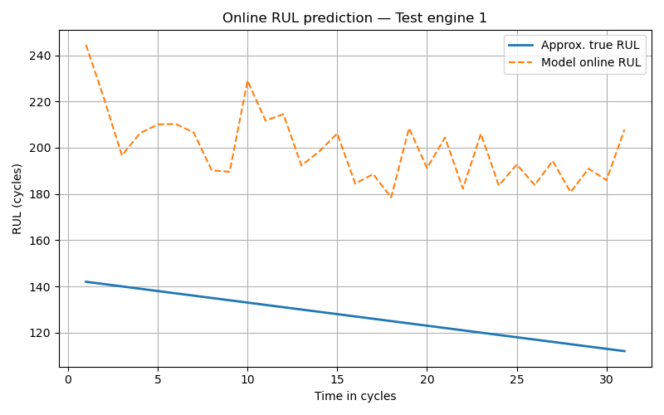
03
Available data
Data overview
The data I have access to is:
Type: Multivariate time-series (3 settings + 21 sensors)
Quantity:
* Train: ~20k rows across 100 engines
* Test: ~13k rows across 100 engines
* RUL: 100 labels for test engines
Labelling: Run-to-failure labels (engine stops at max cycle).
Pre-processing:
* Removed zero-variance signals
* Built aggregated + trend-based features per engine
Each engine is a full time-series. We collapse it into one row per engine and extract statistics + trends describing the full lifespan.
engine1_sensor2.png

Slide 5
04
Project phase summary
Steps – Trials – Milestones
The main steps during my projects were:
Data analysis
• Inspected sensor behaviour and cycle progression to understand degradation patterns.
2. Removing non-informative sensors
• Dropped sensors/settings with zero variance, avoiding noise and improving model stability.
3. Feature extraction (mean, std, min, max)
• Created compact per-engine summaries so models see the overall behaviour, not raw time-steps.
4. Trend creation (slopes, ranges, delta-from-mean)
• Captured how sensors change over time — critical because degradation is a directional process.
5. Train/validation split by engine
• Ensured evaluation is fair by using engines the model has never seen (avoids time-series leakage).
6. Model training
• Compared linear and tree-based models to understand how each handles nonlinearity and collinearity.
7. Lifespan prediction → RUL computation
• Predicted total engine lifespan, then converted to RUL using:
RUL = predicted_lifespan − current_cycle
8. Model evaluation/comparison (RMSE: Root Mean Squared Error, MAE: Mean Absolute Error)
• Used RMSE/MAE to measure error size — RMSE penalizes large mistakes, making it ideal for RUL tasks.
9. Hyperparameter tuning
• Improved Random Forest & GB performance by adjusting tree depth, leaf size, number of estimators.
Trained models:
Linear Regression
Lasso
Gradient Boosting
Random Forest

Slide 6
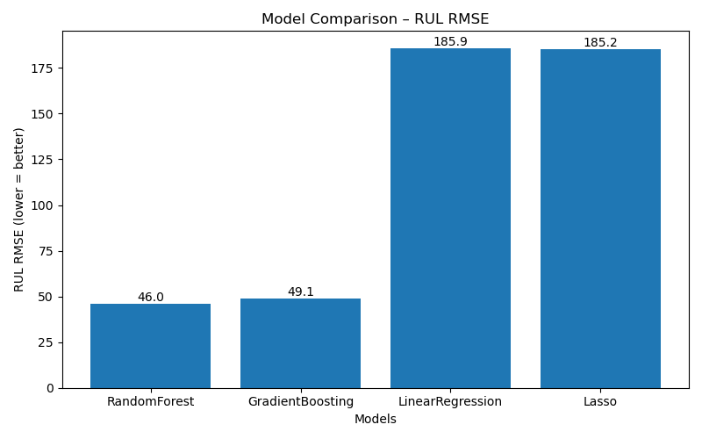
05
Project outcomes
Results – Comparison – Learnings
Key Achievements
Built stable per-engine feature approach
RUL RMSE improved from ~ 32 -> ~ 45 with realistic time-series-aware features
Key Learnings
Time-series dependence matters; naive row-wise models leak information
Sensor trends carry strong predictive power
Collinearity breaks linear models
Tree-based models capture complex degradation signals
Random Forest
Gradient Boosting
LR/Lasso
Model type: Ensemble of decision trees
Model size: Medium-large (hundreds of trees)
Training method: Bagging + random splits
Comment: Best performance — handles nonlinear patterns + collinearity
Model type: Boosted decision trees
Model size: Medium
Training method: Sequential learning (each tree fixes previous errors)
Comment: Strong model, slightly behind RF on this dataset
Model type: Linear model
Model size: Very small (few KB), no trees
Comment: Fast but struggles with nonlinear sensor behaviour

Slide 7
06
Project impact
Future vision & Next steps
Complete remaining Coursera modules.
Extend the project using deeper sequence-based models (LSTM, CNNs, Transformers).
FD001 is a globally used research benchmark — hundreds of papers evaluate RUL models on this dataset, making it ideal for experimentation and comparison.
Potentially alternative application to electric-vehicle components and other sensor-driven systems. (Maybe reusable internal template for Bosch predictive-maintenance work?)

Slide 8

07
QUESTIONS AND DISCUSSION

